Slide 1
Location Estimation
Based on friendships and supervised learning

Slide 2
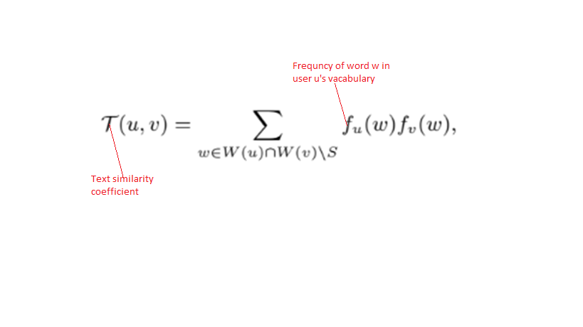
1.Text similarity coefficient
Text similarity analysis between user u and v quantifies the amount of overlap in the vocabularies of users u and v

Slide 3
2.Approximate Co-location measure
Assumption : We make an assumption that once a user tweets from a location, he or she remains at that location until they tweet again.
Captures how much time pairs of users tend to spend close to each other

Slide 4
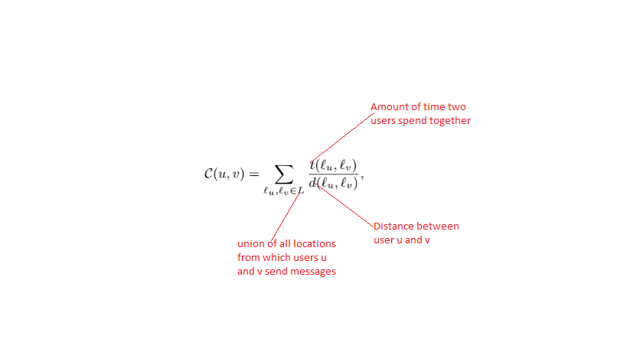

Slide 5
3.Meet/min co-efficient(M)
The standard meet/min coefficient counts the number of common neighbors of u and v
Intuitively, M(u,v) expresses how extensive is the overlap between friend lists of user u and v

Slide 6
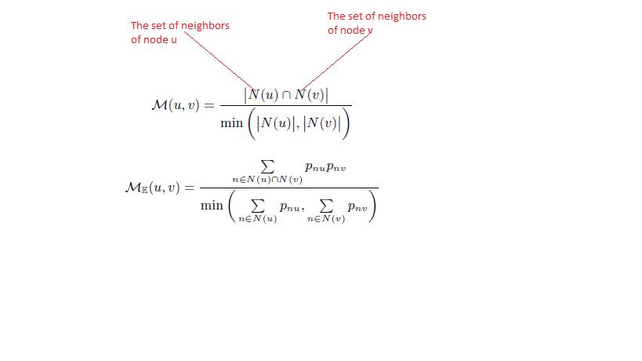

Slide 7
4.Unifiy text coefficient and co-location measure
(Relevant to dynamic Bayesian network)
Since The Text coefficient and co-location measure are always observed, we use a regression decision tree to unify them into DT(u,v).
Observed Varibale:
DT(u,v) = Regression decision tree’s prediction function(x,y)
x = Text coefficient(u,v)
y = co-loation measure(u,v)
Hidden variables
Meet/min (u,v)

Slide 8


5.Learning and Inference friendships
(Relevant to Bayesian Theorem and Markov random field)
Markov random field
Each Hidden node(is connected to a observed node and to all other hidden nodes):
Possible friendship.
Observed node:
DT(u,v)
Bayesian Theorem
Apply Bayes’ Theorem to estimation the existence of friendship between user u and v

Slide 9
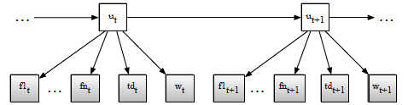
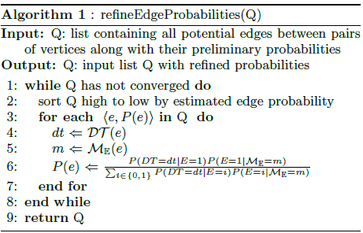

Slide 10
6.Location Prediction
Input:
A sequence of locations visited by one’s friends
Along with the corresponding time
Day Type
Output:
The most likely sequence of locations one visited over the given time period.

Slide 11
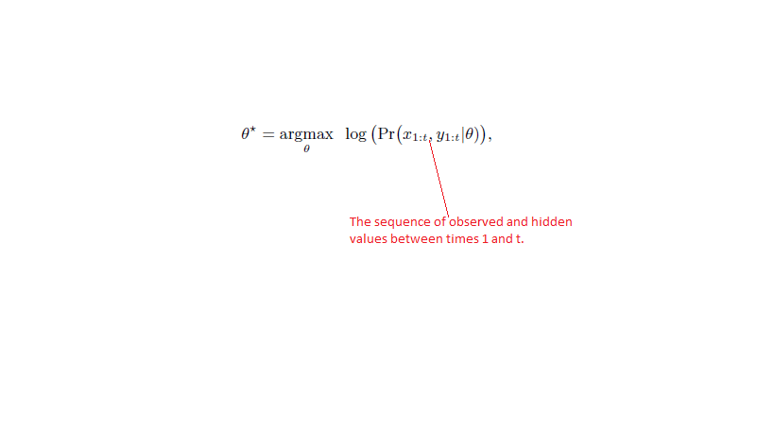
6.1.Learning(Supervised Learning)
Find a set of parameters $θ$ maximize the loglikelihood of the trainning data.

Slide 12
6.2.Inference
Input:
A sequence of locations visited by one’s friends
Along with the corresponding time
Day Type
Output:
The most likely sequence of locations one visited over the given time period.

Slide 13
